Slide 1

Digital Signal Processing Project Title : Audio Read Impulse Noise Detection and Removal of Impulse Signals

Slide 2
NOISE
Is unwanted sound considered unpleasant , loud or disruptive to hearing.
Is indistinguishable from desired sound as both are vibrations through a medium , such as air or water.
TYPES OF NOISE
Photoelectronic
.photon noise
.thermal noise

Slide 3
Impulse
.salt noise
.pepper noise
.salt and pepper noise
.line drop
Structured
.periodic, stationary
.periodic , nonstationary
.aperiodic
.detector striping
.detector banding

Slide 4
Impulse Noise
Is a category of (acoustic) noise that includes unwanted ,almost instantaneous (thus impulse like )sharp sounds(like clicks and pops) typically caused by electromagnetic interference, scratches on disks , and synchronization issues in digital audio.
It describes random occurrences of energy spikes or irregular pulses of short duration ,broad spectral density and relatively high amplitude.
Mostly associated with the construction and demolition industry.
Are commonly created by explosions or construction equipment, such as pile drives

Slide 5
Salt noise
DN=maximum possible
Pepper noise
DN=minimum possible
Salt and pepper noise
. mixture of salt and pepper noise.
. Is a form of noise that is seen on images and audio signals.
.DN is “outlier” relative to neighboring pixel DNs.
.use algorithms that compare test pixel to neighbors.
Line drop
part or all of a line lost

Slide 6
To measure the impulse noise , you will need a sound level meter or personal noise dosimeter that can calculate peak values.
Signals may be corrupted by impulse noise due to noisy sensors or channel transmission errors.
To improve the signal quality , it is important to remove these noises.
We use a classic filter to remove impulse noise is the median filter, at the expense of signal degradation .

Slide 7
Median Filter
Is non-linear digital filtering technique, often used to remove noise from an image or signal .
Such noise reduction is typical pre-processing step to improve the results.
it’s quite common to get better performing impulse noise filter with model-based systems. Which programmed with the time and frequency properties of the noise to remove only impulse obliterated
Samples.

Slide 8
Algorithm Description
The main idea of the median filter is to run through the signal entry by entry, replacing each entry with the median of neighboring entries.
The pattern of neighboring is called the ‘’window’’, which slides, entry by entry, over the entire signal.
For one-dimensional signals, the most obvious window is the first few preceding and following entries.
For two-dimensional signals, the window must include all entries within the given radius.

Slide 9
Algorithm implementation
The filter must process every entry in the signal, for large signals such as images.
The efficiency of this median calculation is a critical factor in determining how fast the algorithm can run.
Only the middle value in a list of numbers required, selection algorithm can be much more efficient.

Slide 10
Procedure
Adding audio file to MATLAB.
Generating the impulse noise
Combining the two signals to form impulse noise disturbed audio signal.
Then we used the above-mentioned Median filter to reduce and filter out the noise.
After filtering and noise reduction we were able to recover our pure audio signal.

Slide 11
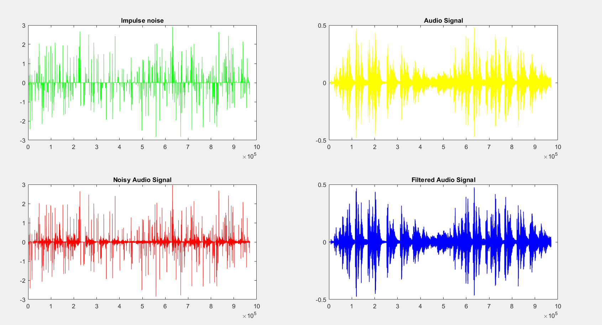
Final Matlab Output Plot

